Slide 1

Makeall Engitech Pvt. Ltd.
Company Presentation

Slide 2
Introduction
Makeall Engitech Pvt. Ltd.
(A manufacturing unit established in September, 2018)
Office : S. No. 126/1A, A8/102. Kunal Icon, Pimple Saudagar,
Pune, 411027
Works : Laxmi Niwas, Near Malan Farm, Tathawade,
Pune – 411033
Contact : +91 – 8805830566
E-mail : sales.makeall@gmail.com,
ponkshepp@gmail.com

Slide 3
Introduction
Makeall Engitech Pvt. Ltd.
CIN No : U74999PN2018PTC178860
PAN No : AAMCM1546Q
TAN No : PNEM27518B
GSTIN No : 27AAMCM1546Q1Z5
Udyog Aadhar No : MH26B0087044
Our Banker : INDIAN Bank, Bhosari Branch, Pune – 411039
Account No : 6689424229
IFSC code : IDIB000B174

Slide 4
Introduction
Company headed by two directors:
1) Prashant Ponkshe – Director
BE. Mech / DME with 30 years of experience in manufacturing
industry.
2) Shreyas Ponkshe – Additional Director
B.E. Electonics with 2 years of experience co-founder of
SP solutions LLP which involved in Electronics product
Development and software development.

Slide 5
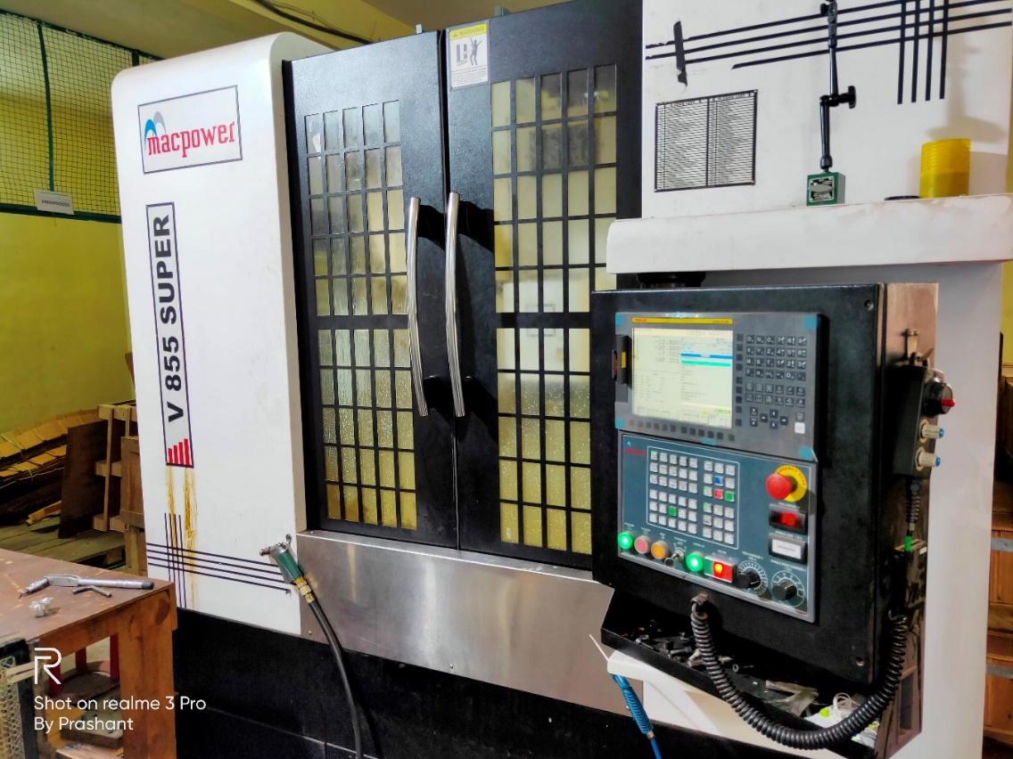
Infrastructure
Details of NEW machines -
VMC – MACPOWER make Model V550 Super
Specifications:
Table = 1050*500 mm
Stroke = 850*550*500 mm
Spindle = 7.5/11 Kw
Speed = 8000 RPM
Table load = 800 Kg
4Th axis = UCAM dia. 200

Slide 6
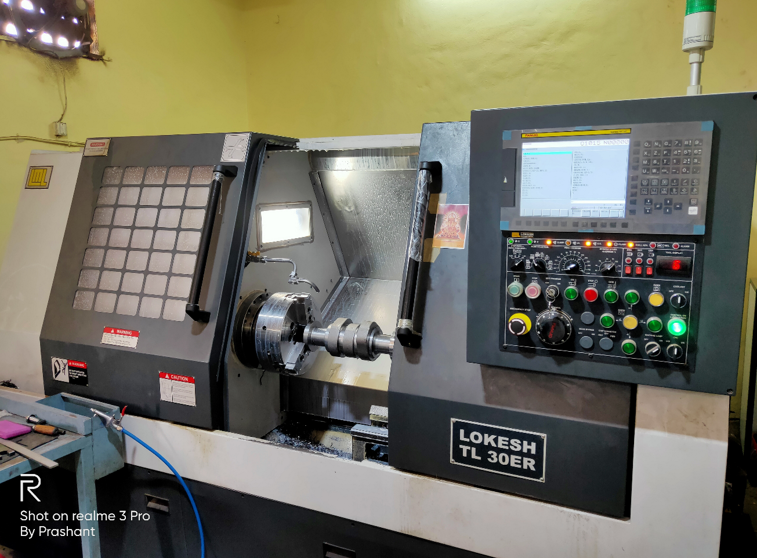
Infrastructure
CNC Turning Center – LOKESH make Model TL30ER
Specifications:
Chuch dia. = 315 mm
Max. Turn dia = 400 mm
Max Turn length = 500 mm
Turreet = 12 Station (Pragati)
Power = 11/15 Kw
Roller LM Guideways

Slide 7
Our expertise
Machining of small to medium sized precision components
from raw to finish.
Material is no constraint, we have expertise in machining of
Steel, Stainless steel, Cast Iron and non-ferrous components
either with or without material.
We have tied up with reliable sources for Casting, forging,
Fabricated components and pattern makers.
We have tied up with Test Labs for material testing and
CMM inspection.

Slide 8
Other Services
We also offer consultancy in following area –
Production & Syatems -
  CNC machine & Tooling selection.
  Jig & Fixture designing and manufacturing.
  Productivity improvement through CNC program,
  process / method optimization & elimination of MUDA.
  Work study, Method study and Time study.
  System improvements using 5S & layout change.
Quality –
  Onsite inspection or process witnessing activity
  at vendor site
  Vendor assessment or vendor audit.

